Slide 1
EagleSat-1: Flight Operations
Madison Padilla
Embry-Riddle Aeronautical University Aerospace Engineering, Senior
AZ/NASA Space Grant Symposium
April 13-14, 2018

Slide 2
Overview
Ground system overview
Ground system breakdown
Graphic user interface (GUI) layout
Flight dynamics overview
Flight dynamics analysis
Questions

Slide 3
Ground System Overview
A ground system to provide a Graphical User Interface (GUI) that is able to connect to EagleSat-I through a serial connection to the Terminal Node Controller (TNC)
View, save, observe and process data from EagleSat-I
Matrix Laboratories (MATLAB) chosen for all ground station software

Slide 4
Ground System Breakdown

Slide 5
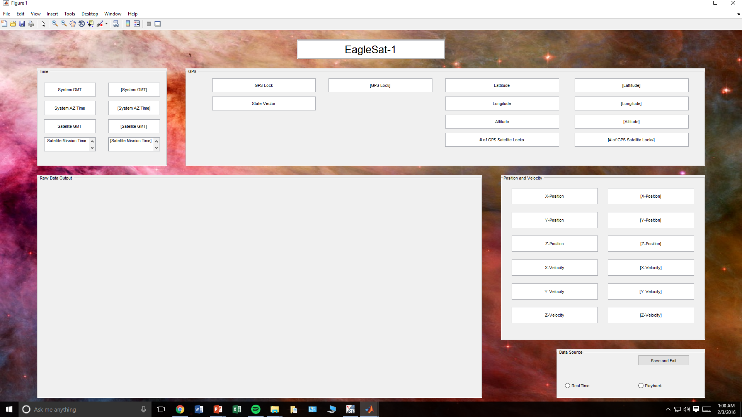
1. Time
2. GPS
4. Position and Velocity
3. Raw Data Output
Position and Velocity
X, Y, Z position
X, Y, Z velocity
5. Data Source
Buttons for real-time or playback
Save and exit
2. GPS
GPS Lock
State Vector
Latitude and Longitude
Altitude
Number of satellite locks
3. Raw Data Output
Time
System Greenwich Mean Time (GMT)
System AZ Time
Satellite GMT
Satellite Mission Time
5. Data Source

Slide 6
Flight Dynamics Overview
Main objective: To calculate and incorporate drag in order to predict the deorbit time on the EagleSat-I
Orbital Predictions:
Altitude at apogee: 818.0 km
Altitude at perigee: 453.0 km
Inclination: 97.7°
Launch date: November 18, 2017
All flight dynamics analysis was done in Systems Tool Kit 11 (STK)
Two-Line Element sets for EagleSat-I were obtained from Space-Track.org

Slide 7
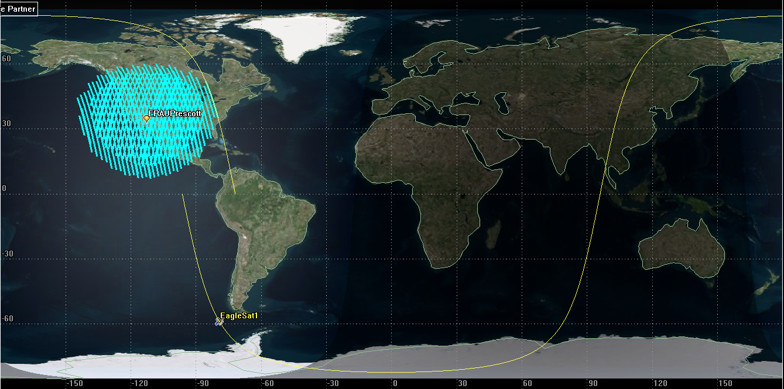
STK Simulation Example

Slide 8
Flight Dynamics – Coverage
Predicted passes over Ground Station (located in ERAU’s AXFAB)
3 to 6 passes per day
2-3 passes within approx. 1-2 hours, separated by approx. 8-10 hour intervals
Mean coverage time: approximately 10 minutes
Optimal downlink time was determined by the local start time and the duration of the pass
EagleSat1-To-ERAU
 | Start Time |  | End Time |  | Duration |  | Optimal Downlink Time
Access Number | UTC Start | Local Start Time | UTC End Time | Local Time End | In Seconds | In Minutes | Yes/No
1 | 3/28/18 6:50 PM | 11:50:14 AM | 3/28/18 7:02 PM | 12:02:18 PM | 724.082 | 12.07 | Yes
2 | 3/28/18 8:24 PM | 1:24:49 PM | 3/28/18 8:39 PM | 1:39:32 PM | 882.645 | 14.71 | Yes
3 | 3/28/18 10:05 PM | 3:05:48 PM | 3/28/18 10:12 PM | 3:12:56 PM | 428.64 | 7.14 | No

Slide 9
Flight Dynamics – Orbital Decay
Analysis for the orbital decay of EagleSat-I was based on the updated TLE’s provided
Calculations for the orbital decay were completed in STK
EagleSat-I’s drag area was set
to 0.02 m^2 to accommodate
for tumbling
Simulation # | Start Date (mm/dd/yyyy) | Projected Orbital Decay (Years)
0 | 11/18/2017 | 6.8
1 | 1/25/2018 | 6.7
2 | 2/8/2018 | 6.7
3 | 2/15/2018 | 6.7
4 | 2/22/2018 | 6.6
5 | 3/1/2018 | 6.6
6 | 3/8/2018 | 6.6
7 | 3/22/2018 | 6.5
8 | 3/28/2018 | 6.4

Slide 10
Acknowledgements
Dr. Gary Yale
Dr. Kaela Martin
Dr. Julio Benavides
Flight Operations team members Kyle Noland, Tyler Noland and Yashica Khatri

Slide 11
Questions? Madison Padilla padillm3@my.erau.edu

